Slide 1
Targets

Slide 2
CRANIDOS

Slide 3
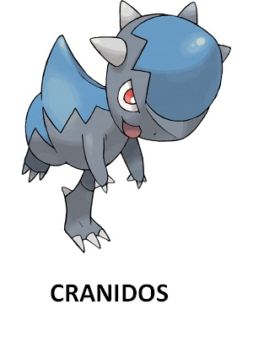

Slide 5
CRANIDOS

Slide 6
CRANIDOS

Slide 7
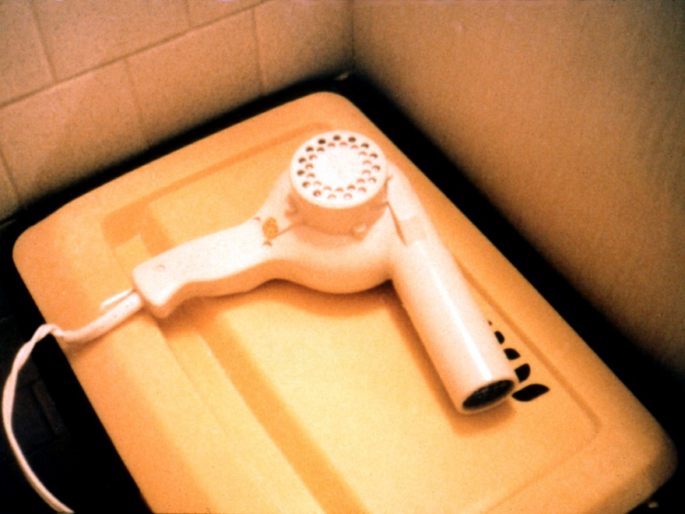

Slide 8
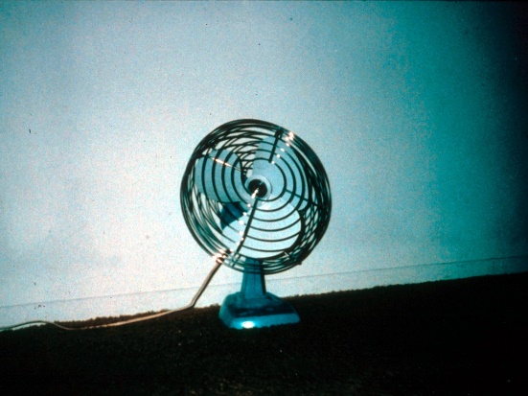
CRANIDOS

Slide 9
BOOK

Slide 10
UMBRELLA

Slide 11
GLASSES
CRANIDOS

Slide 12
shelmet

Slide 13


Slide 15
SHELMET

Slide 16
SHELMET

Slide 17
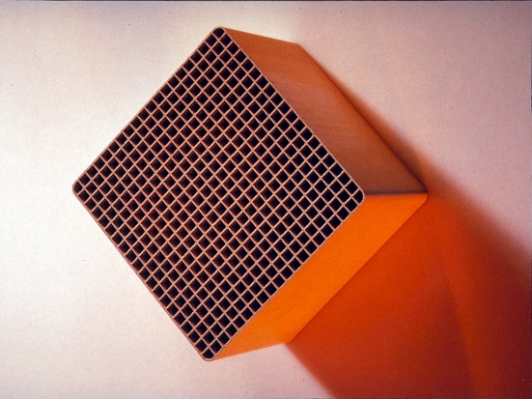

Slide 18
SHELMET

Slide 19
CONCRETE

Slide 20
GLASSES

Slide 21
SHELMET
PENCILS

Slide 22
zorua

Slide 23
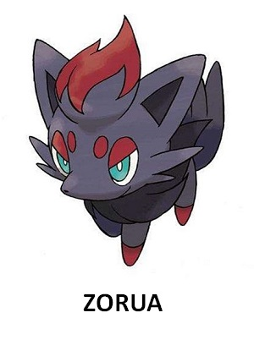

Slide 25
ZORUA

Slide 26
ZORUA

Slide 27
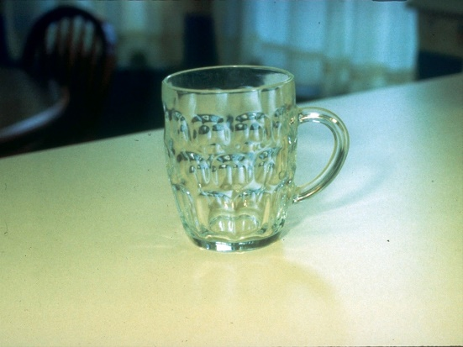

Slide 28
ZORUA

Slide 29
BOOK
ZORUA

Slide 30
COMPUTER

Slide 31
PENCILS

Slide 32
magearna

Slide 33
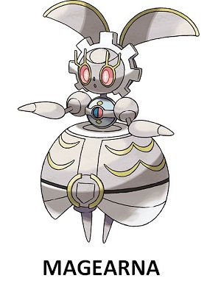

Slide 35
MAGEARNA

Slide 36
MAGEARNA

Slide 38

MAGEARNA

Slide 39
MAGEARNA
UMBRELLA

Slide 40
COMPUTER

Slide 41
PENCILS

Slide 42
Bergmite

Slide 43
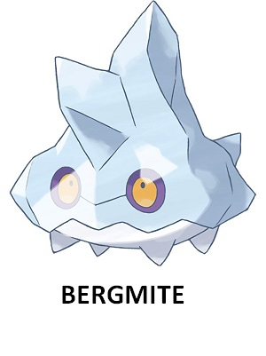

Slide 45
BERGMITE

Slide 46
BERGMITE

Slide 47


Slide 48
BERGMITE

Slide 49
BERGMITE
BOOK

Slide 50
CONCRETE

Slide 51
UMBRELLA

Slide 52
Fillers

Slide 54
CONCRETE

Slide 55


CONCRETE

Slide 59
COMPUTER

Slide 60
COMPUTER

Slide 62
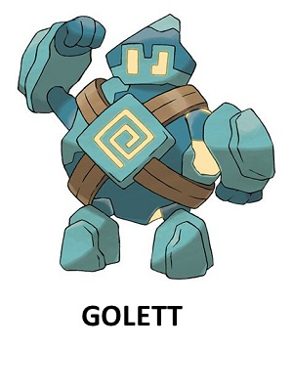

Slide 63
UMBRELLA

Slide 64
UMBRELLA

Slide 65
BOOK

Slide 66
BOOK

Slide 67
CONCRETE

Slide 68
GLASSES

Slide 69
COMPUTER

Slide 70
PENCILS

Slide 82
PENCILS
BOOK

Slide 83
PENCILS
BOOK

Slide 84
COMPUTER
UMBRELLA

Slide 85
CONCRETE

Slide 86
CONCRETE

Slide 87
GLASSES

Slide 88
GLASSES

Slide 89
BOOK

Slide 90
BOOK

